Slide 1

Review
23MEP501- Reverse Engineering Project
REVERSE ENGINEERING OF HYDRAULIC DISC AND CALIPER
Batch Members
727623BME009 PRIYANKA B
727623BME010 VISHNU PRASANTH V
727623BME038 GOKULAKANNAN S
Guide Details:
Dr. K. Hariharan, ASP/Mech
Date: 08.11.2025

Slide 2
Contents
Product &Specification
Core functionality
Principle & Mechanisms
Measurement Evidence
Measurement sketch
Mesured Diagram
Individual Part Measurement
8. 3D Model of the disk caliper
9. Exploded View of the component
10. Assembly Drafting
11. Design Modification
12. Fabrication of Critical Component
13. Bill of material
14. References

Slide 3
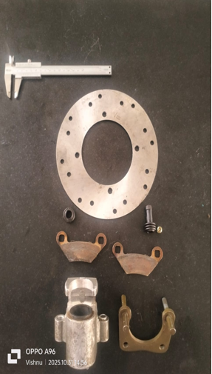
Product &Specification
Imagine you're driving on a busy highway and suddenly need to brake because a car in front of you slams on its brakes. The brake disc, working in conjunction with the brake pads, is what allows you to slow down and avoid a collision. Without the brake disc, the wheel would continue spinning, and you wouldn't be able to stop the vehicle effectively.
Specification:
Type: Hydraulic single disc brake
Disc Size: 230 mm (ventilated / perforated steel disc)
Caliper: Single-piston floating type
Brake Fluid: DOT 3 / DOT 4 (non-compressible hydraulic fluid)
Mounting: Rear wheel hub with caliper bracket connected to the swing arm

Slide 4
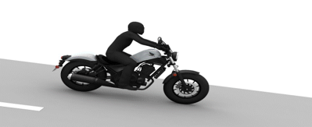
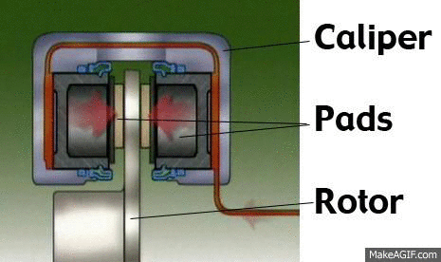
Core Functionality
Disc brakes work by converting the kinetic energy of a moving vehicle into heat energy through friction, ultimately slowing down or stopping the vehicle.
When the brake pedal is pressed, brake pads are forced against a rotating disc (rotor), and the friction between the pads and the disc generates heat, causing the vehicle to decelerate.

Slide 5
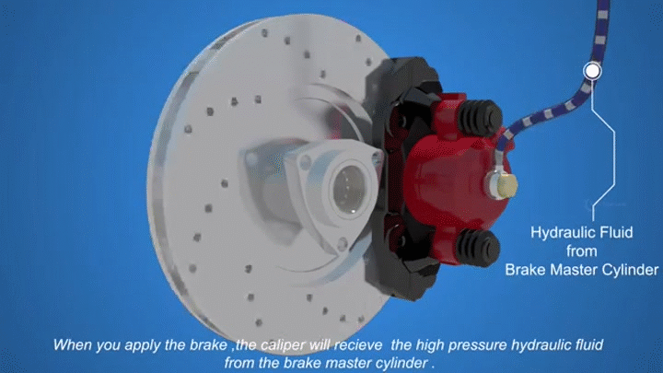
Principle & Mechanisms
Principle: Works on Pascal’s Law — pressure applied to a confined fluid is transmitted equally in all directions.
Components: Brake pedal, master cylinder, brake fluid, pipes, wheel cylinder/caliper, brake pads/disc.
Working Steps:
Pedal pressed → force applied to master cylinder.
Fluid pressure transmitted through brake lines.
Pressure pushes caliper pistons → pads press the disc.
Friction slows or stops wheel rotation.
On release → pressure drops, pads return to position.
Understand:
Converts pedal force into hydraulic pressure for smooth and effective braking.

Slide 6
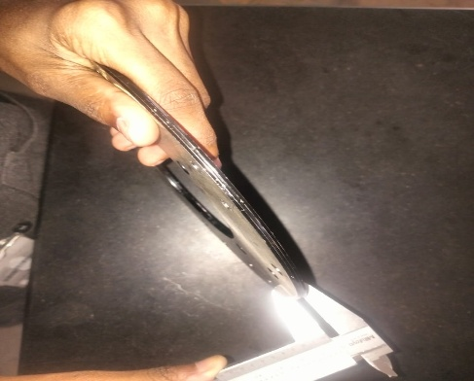
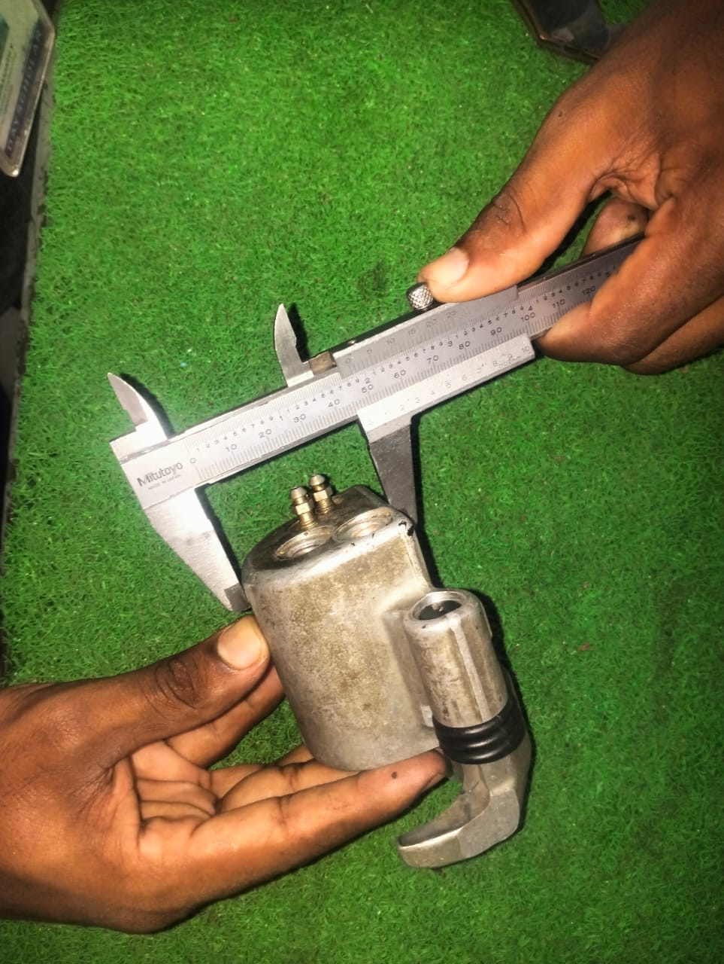
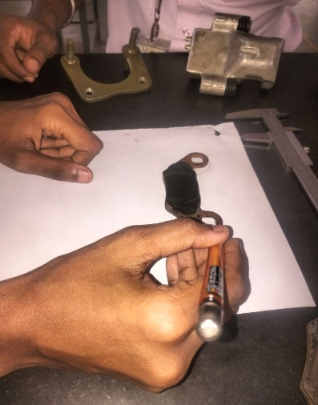
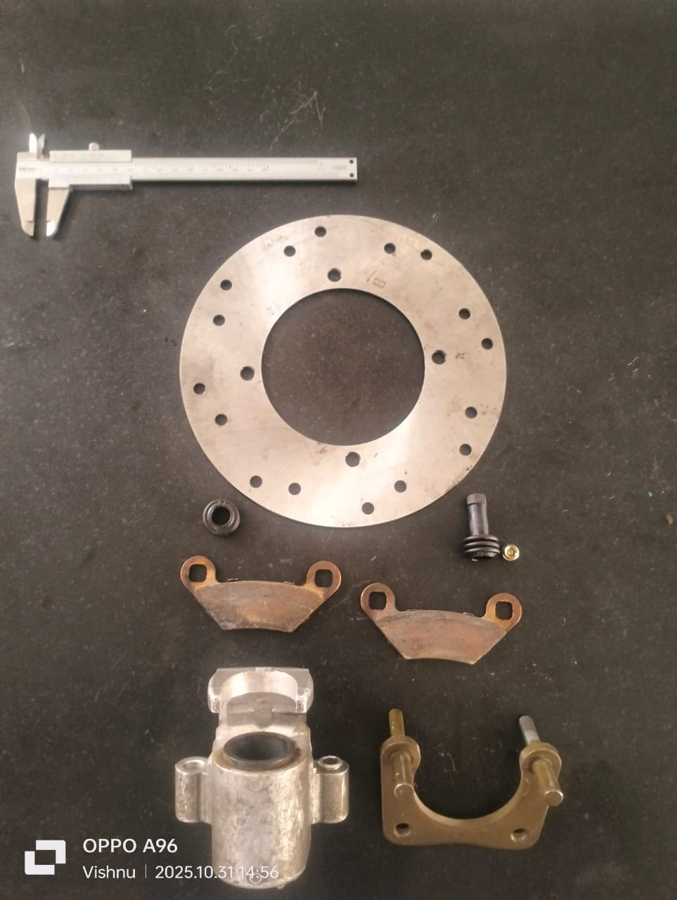
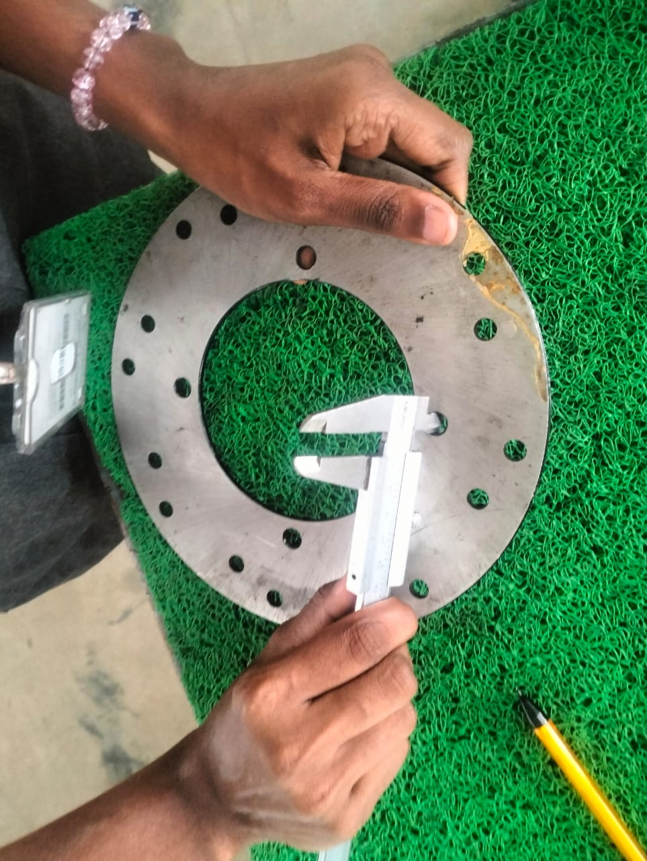
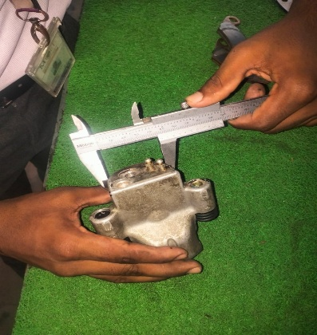
Measurement Evidence
Instrument user:
1)Vernier caliper
2)Steel ruler
3)Traditional method
(paper stacking )

Slide 7
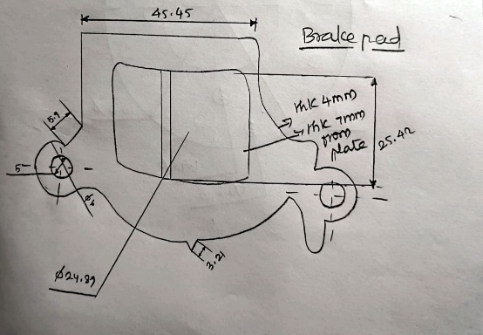
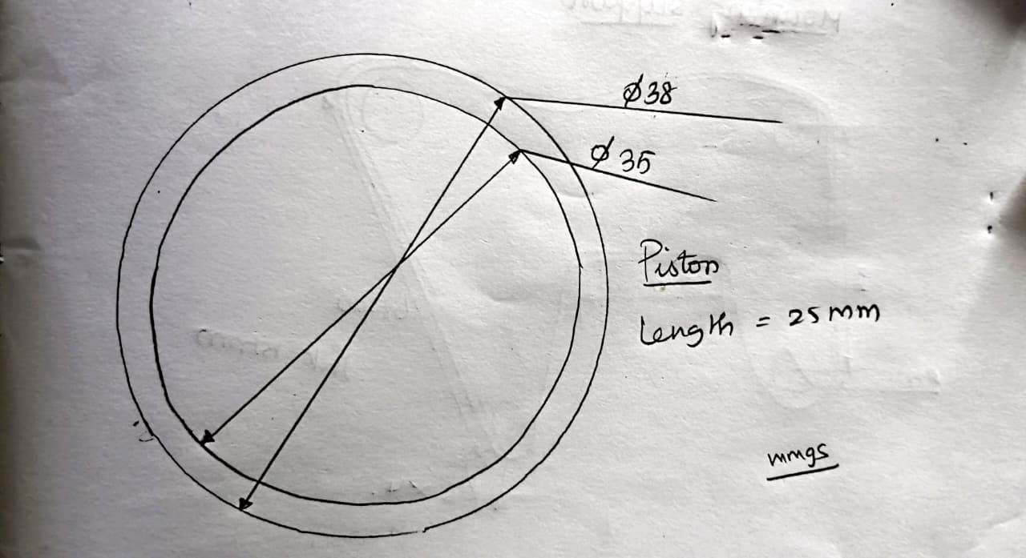
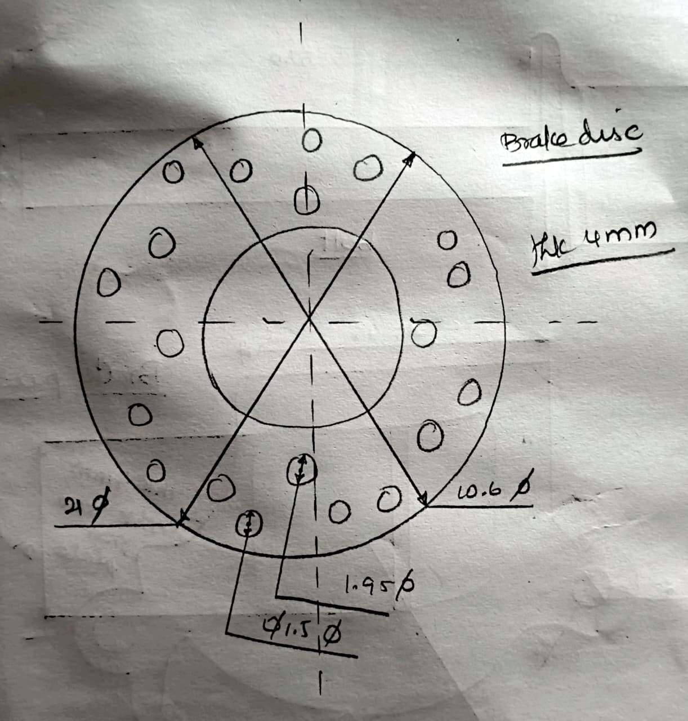
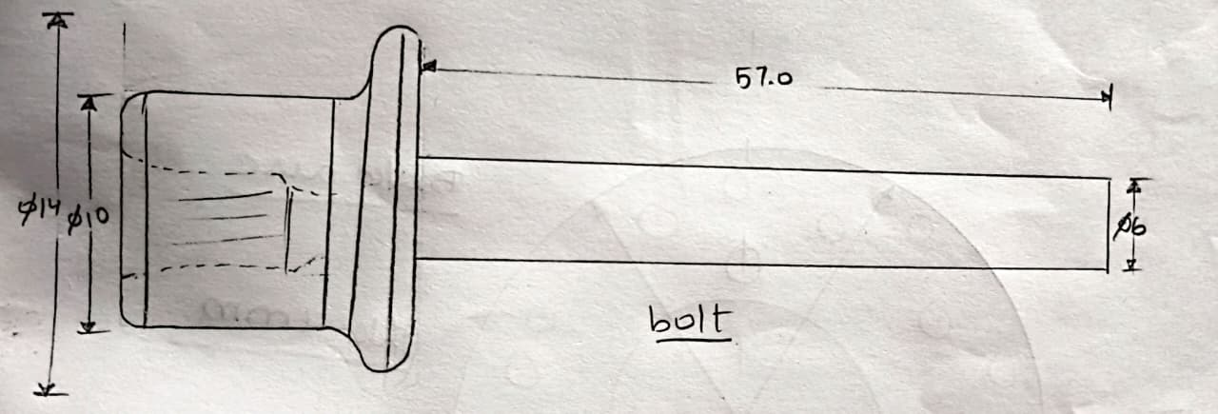
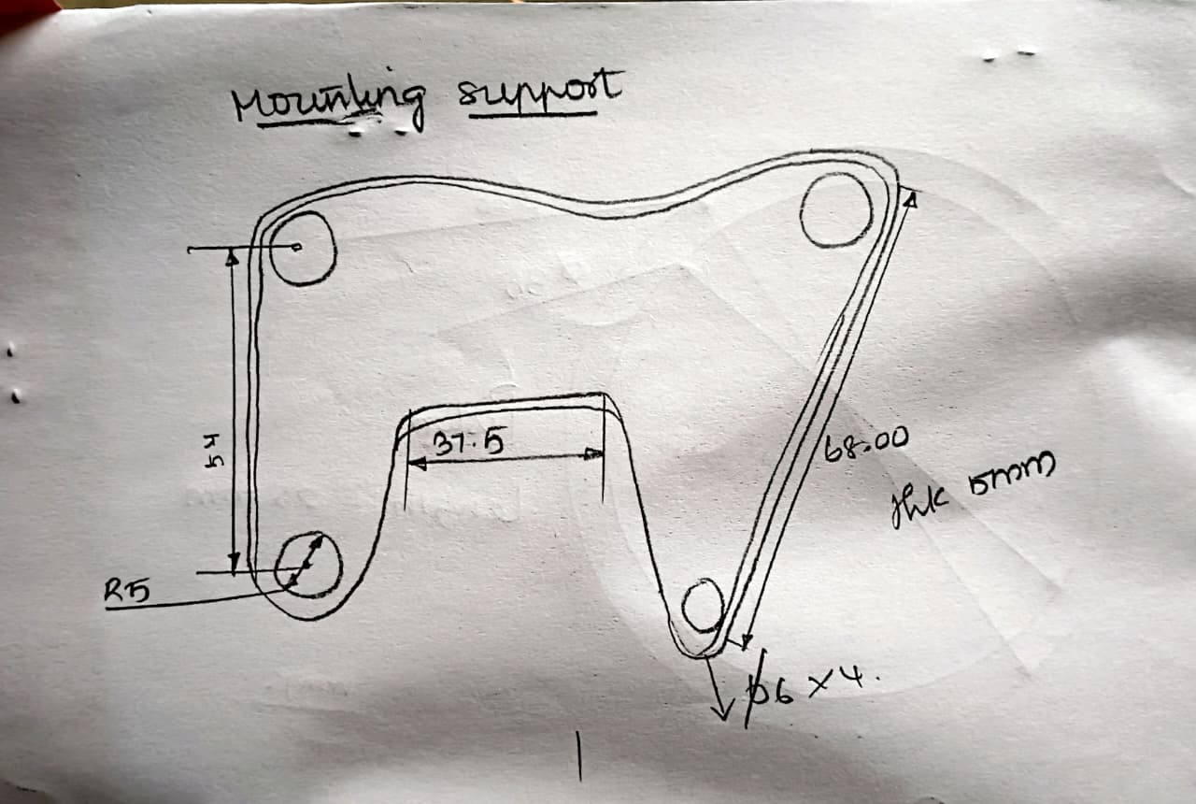
Measurement sketch

Slide 8
Mesured Diagram
Part name | Type of dimension | MSR | VSD | LC | Total reading
Disc | Diameter | 209.4 | 23 | 0.02 | 210
 |  | 8.1 | 10 | 0.02 | 8
 |  | 8.1 | 12 | 0.02 | 8
 | Thickness | 3.8 | 01 | 0.02 | 4
piston | Diameter | 34.8 | 14 | 0.02 | 35
 |  | 38.2 | 09 | 0.02 | 38
 | Length | 25.2 | 10 | 0.02 | 25
Brake pad | Length | 55.5 | 10 | 0.02 | 55
 |  | 67.8 | 25 | 0.02 | 68
 | Diameter | 6 | 16 | 0.02 | 6
 | Fillet (Assume) |  |  |  | 5
 | Thickness (ceramic) | 3.45 | 35 | 0.02 | 4
 | Total thickness | 6,45 | 23 | 0.02 | 7
Part name | Type of dimension | MSR | VSD | LC | Total Reading
Caliper | Length | 40.1 | 5 | 0.02 | 40
 |  | 46.9 | 13 | 0.02 | 47
 |  | 31.5 | 34 | 0.02 | 32
 |  | 24.63 | 21 | 0.02 | 25
 |  | 15.2 | 26 | 0.02 | 15
 |  | 33.7 | 15 | 0.02 | 34
 |  | 49.9 | 3 | 0.02 | 50
 | Diameter | 21 | 5 | 0.02 | 21
 |  | 10.1 | 8 | 0.02 | 10
 |  | 21.3 | 9 | 0.02 | 21
 |  | 9 | 1 | 0.02 | 9
Bolt | Diameter | 6 | 0 | 0.02 | 6
 |  | 10 | 0 | 0.02 | 10
 | Length | 57 | 0 | 0.02 | 57

Slide 9
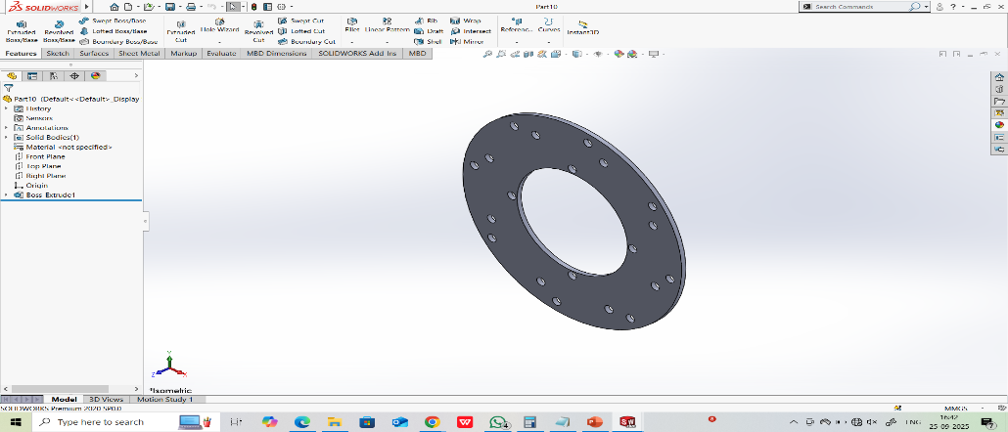
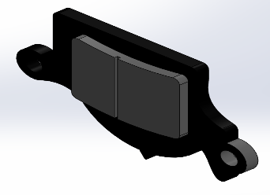
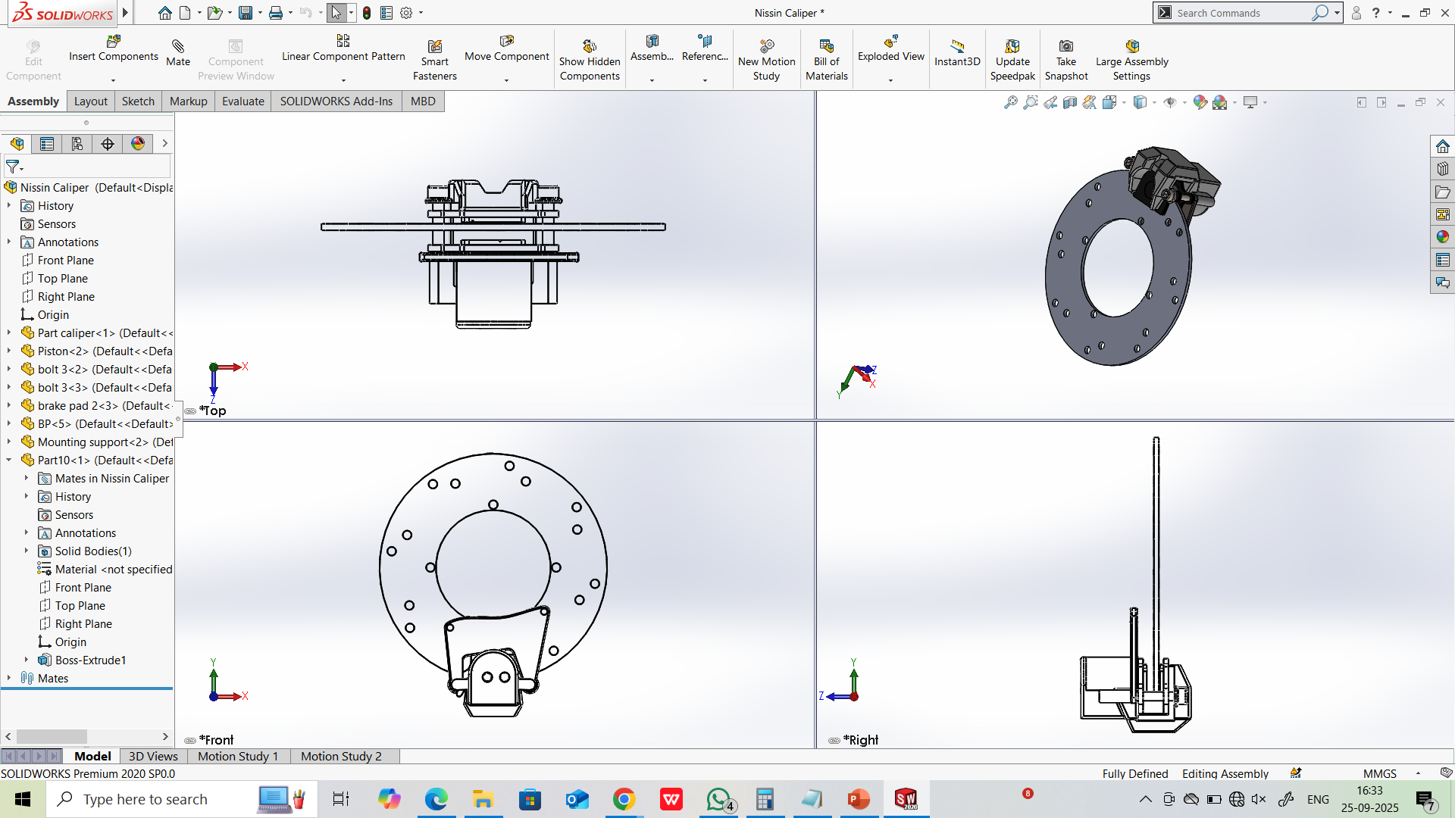
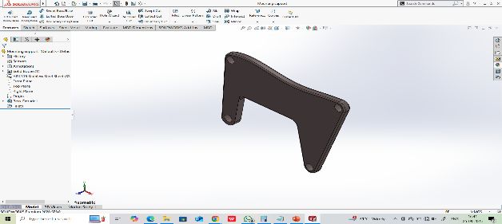
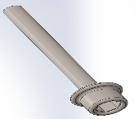
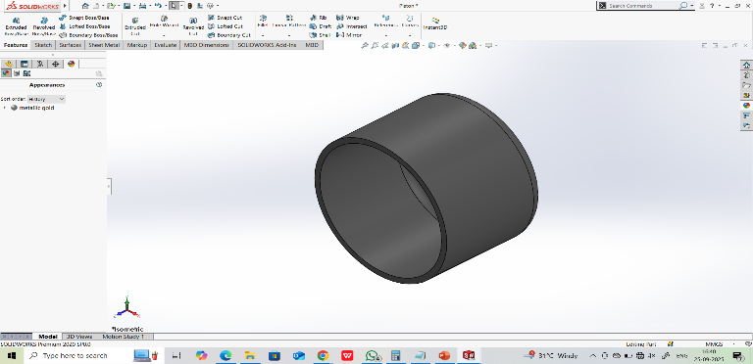
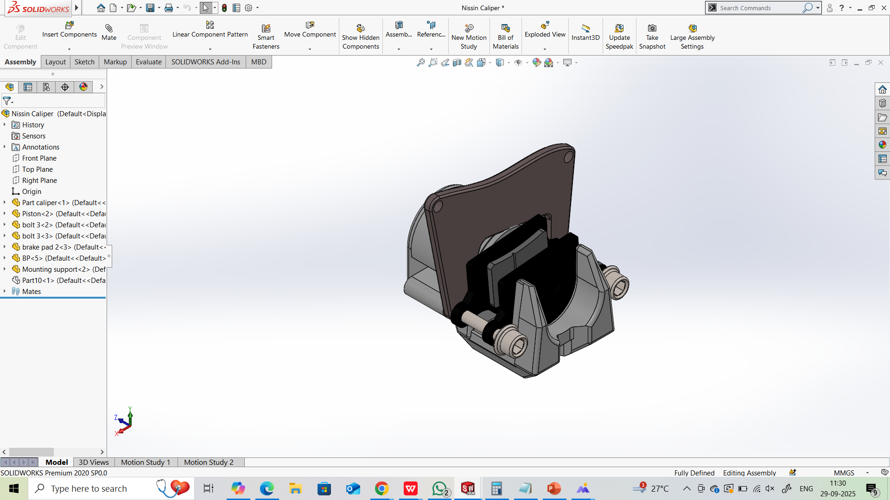
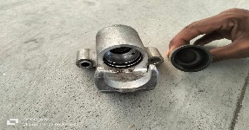
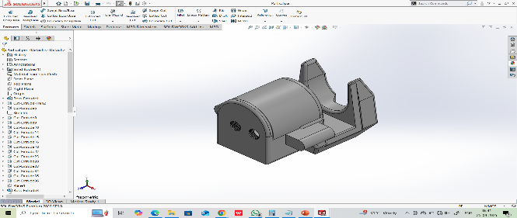
List of the Part
Rotor
Brake pad
Disk brake
Mount and screw
Caliper Assembly
Piston
Caliper Sub -Assembly
Caliper

Slide 10
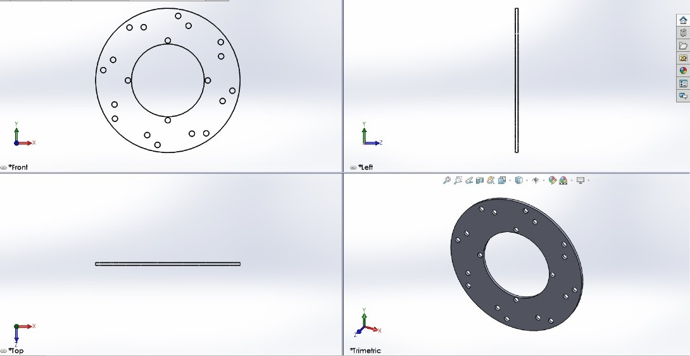
DISC

Slide 11
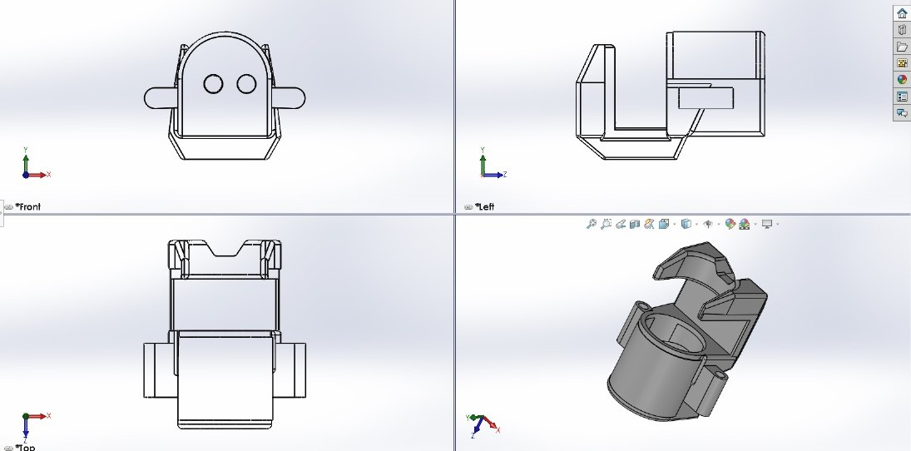
CALIPER

Slide 12
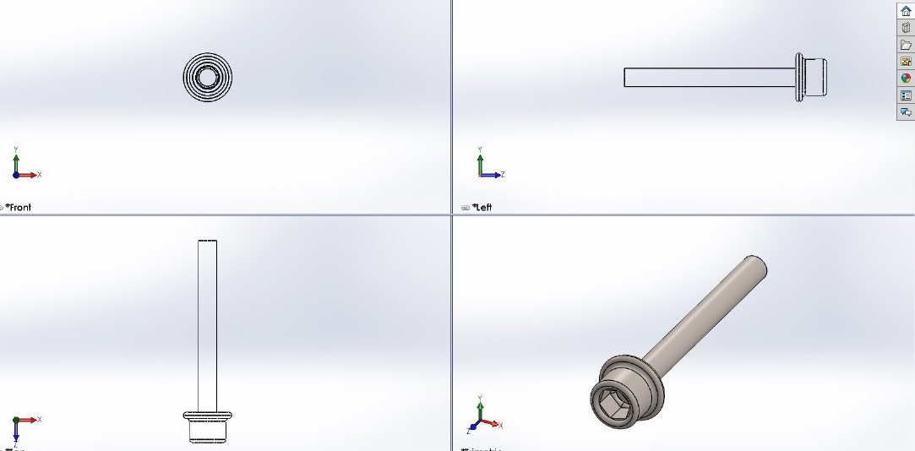
BOLT

Slide 13
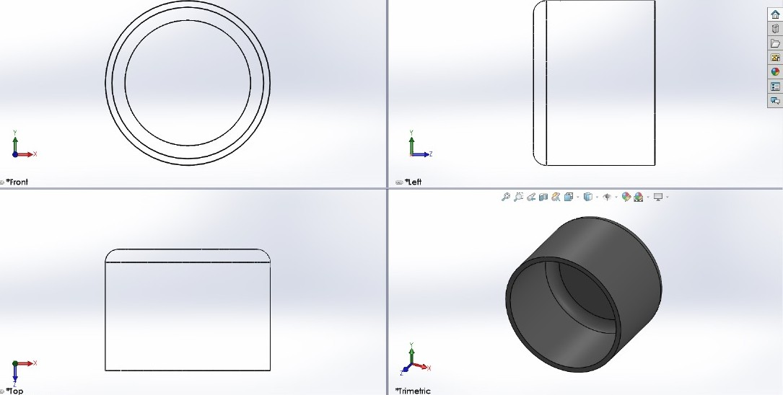
PISTON

Slide 14
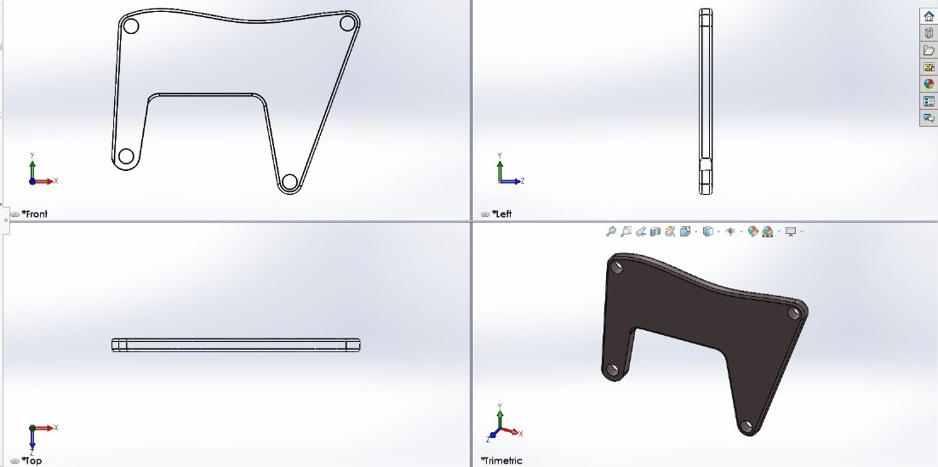
MOUNTING SUPPORT

Slide 15
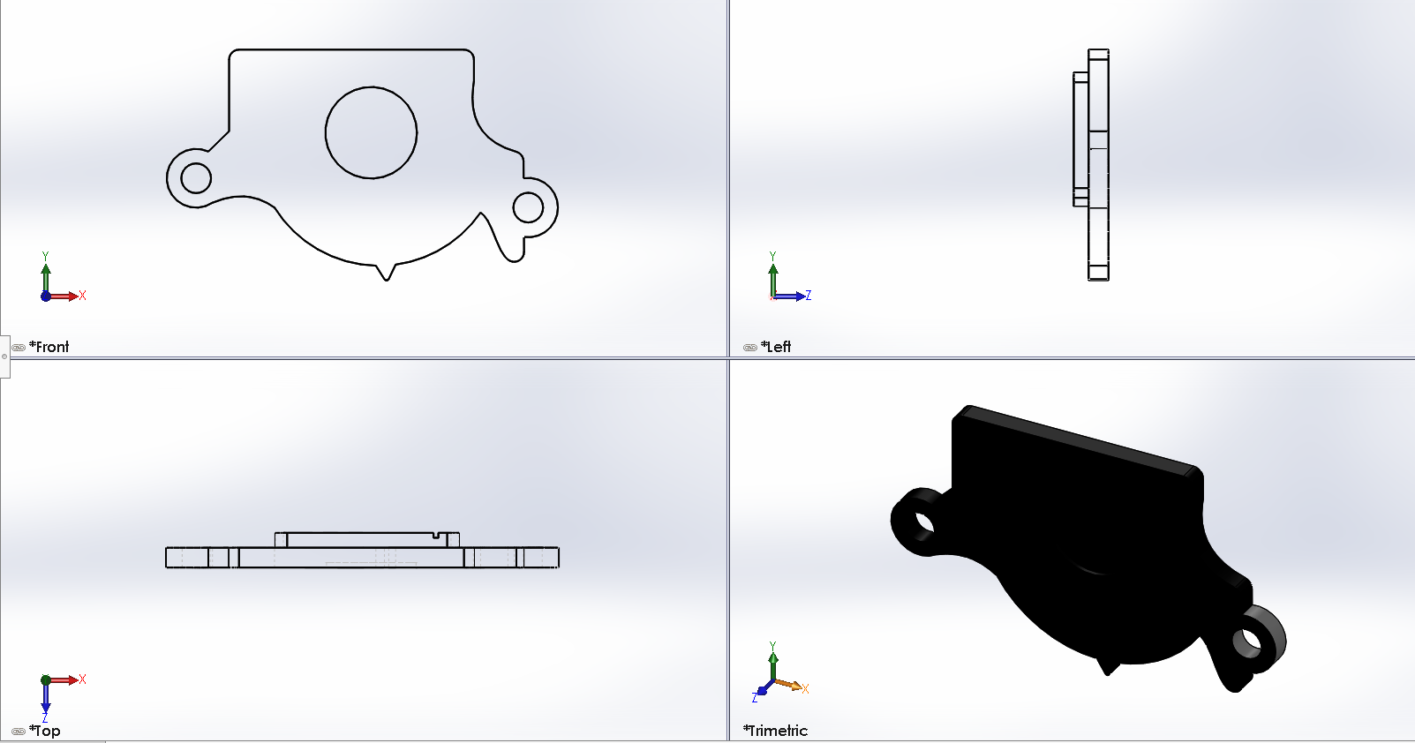
Brake pad

Slide 16
3D Modelling Disk brakes system
Bill of Materials
Item No | Item Name | Quantity
6 | Caliper | 01
5 | Brake pad | 02
4 | Piston | 01
3 | Holder | 01
2 | Bolt | 01
1 | Disk | 01

Slide 17
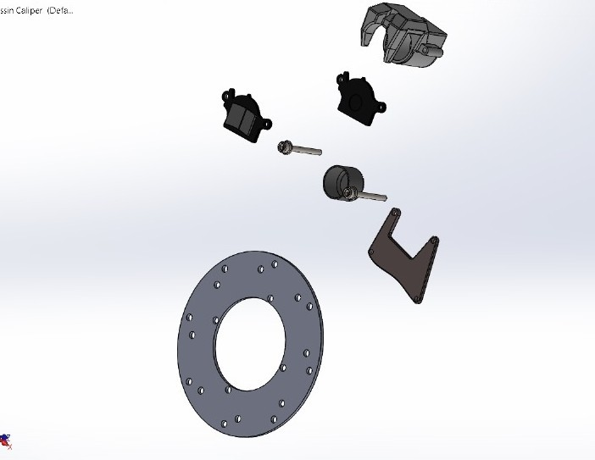
EXPLODED VIEW

Slide 18
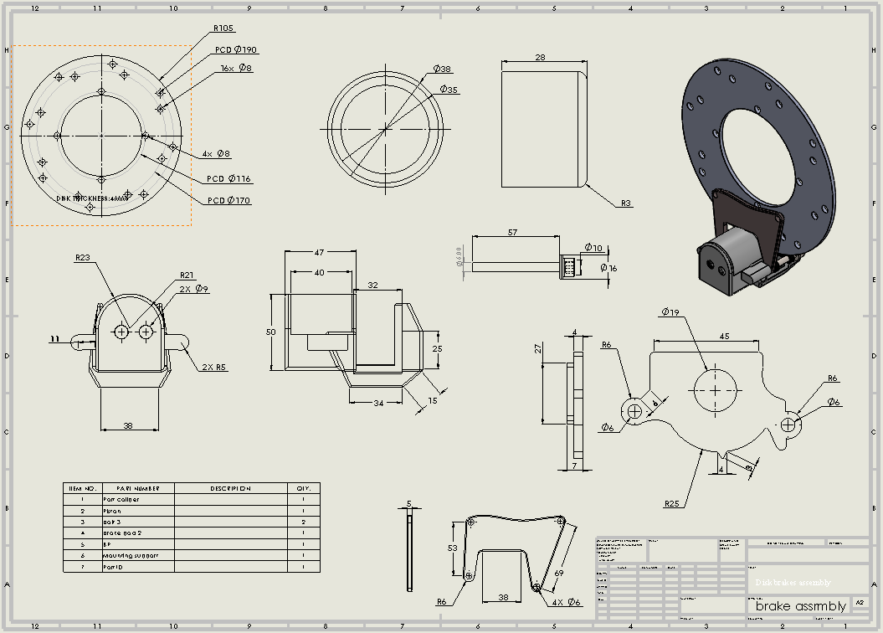
Assembly Drafting

Slide 19

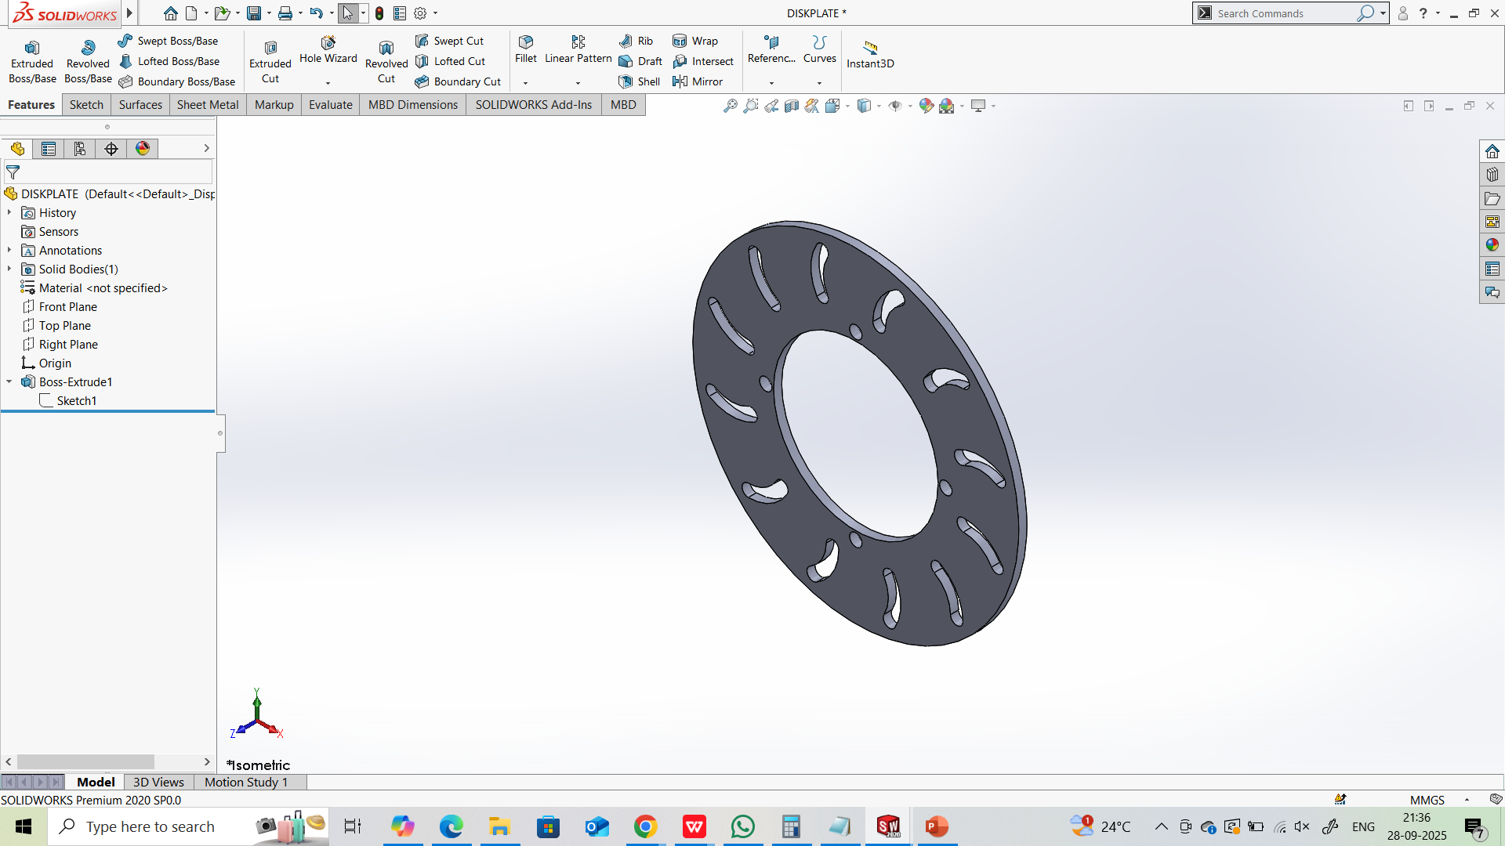
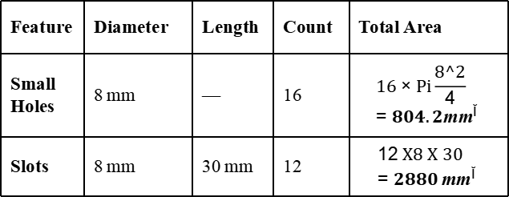
Design modification
Heat Flow Comparison: Small Holes vs Slots
1)Ventilation Area
Feature | Diameter | Length | Count | Total Area
Small Holes | 8 mm | — | 16 | $$16×Pi\frac{8^2}{4}=804.2{\text{mm}}^{2}$$
Slots | 8 mm | 30 mm | 12 | $$12 X8 X 30=2880 {\text{mm}}^{2}$$
Small hole :8 mm
Slot :8 x 30 mm

Slide 20
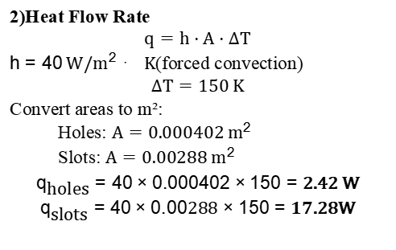
Design modification
2)Heat Flow Rate
$$q=h⋅A⋅ΔT$$
$h=40 {\text{W}\text{/}\text{m}}^{2}⋅\text{K}$(forced convection)
$$ΔT=150 \text{K}$$
Convert areas to m²:
Holes: $A=0.000402 {\text{m}}^{2}$
Slots: $A=0.00288 {\text{m}}^{2}$
$$q_{\text{holes}}=40×0.000402×150=\text{2}\text{.}\text{42} \text{W}$$
$$q_{\text{slots}}=40×0.00288×150=17\text{.}\text{28}\text{W}$$
Results:
Slots dissipate ~7× more than small holes heat per second under the same conditions

Slide 21
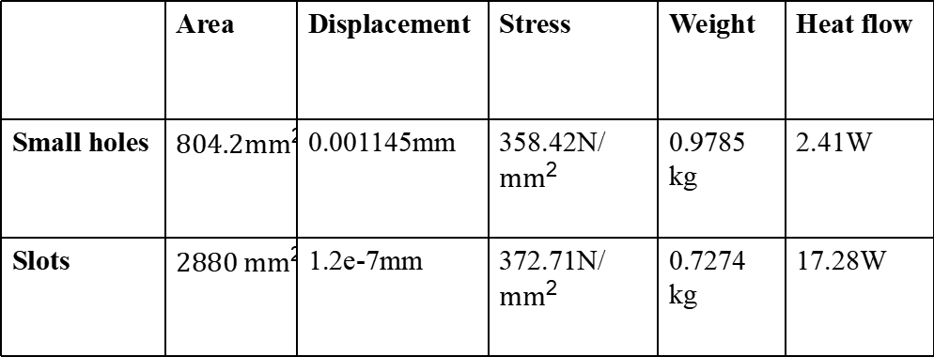
Design modification
Result comparison table:
 | Area | Displacement | Stress | Weight | Heat flow
Small holes | $$804.2{\text{mm}}^{2}$$ | 0.001145mm | 358.42N/${\text{mm}}^{2}$ | 0.9785 kg | 2.41W
Slots | $$2880 {\text{mm}}^{2}$$ | 1.2e-7mm | 372.71N/${\text{mm}}^{2}$ | 0.7274 kg | 17.28W

Slide 22
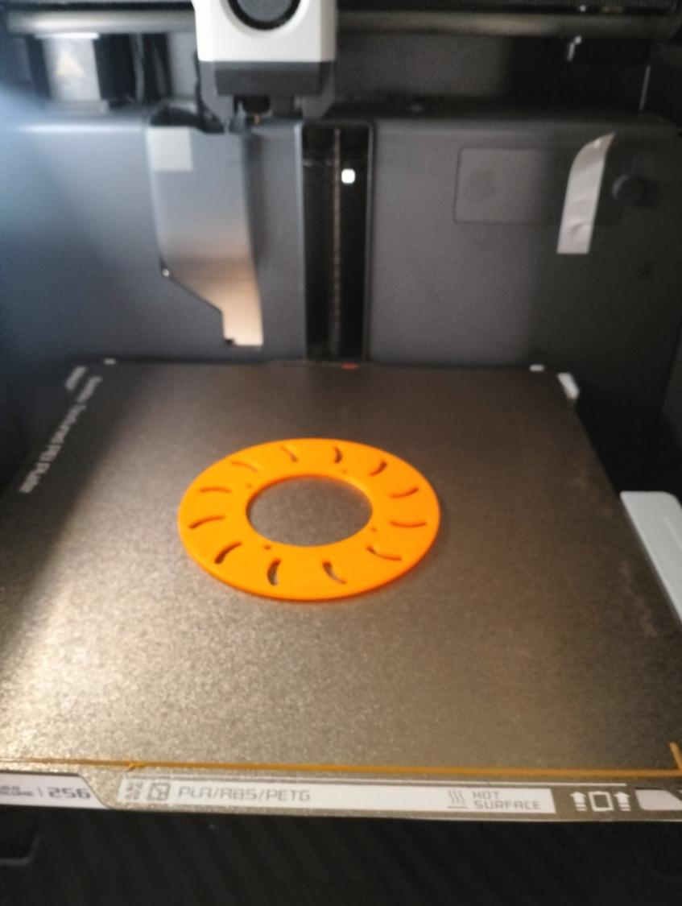
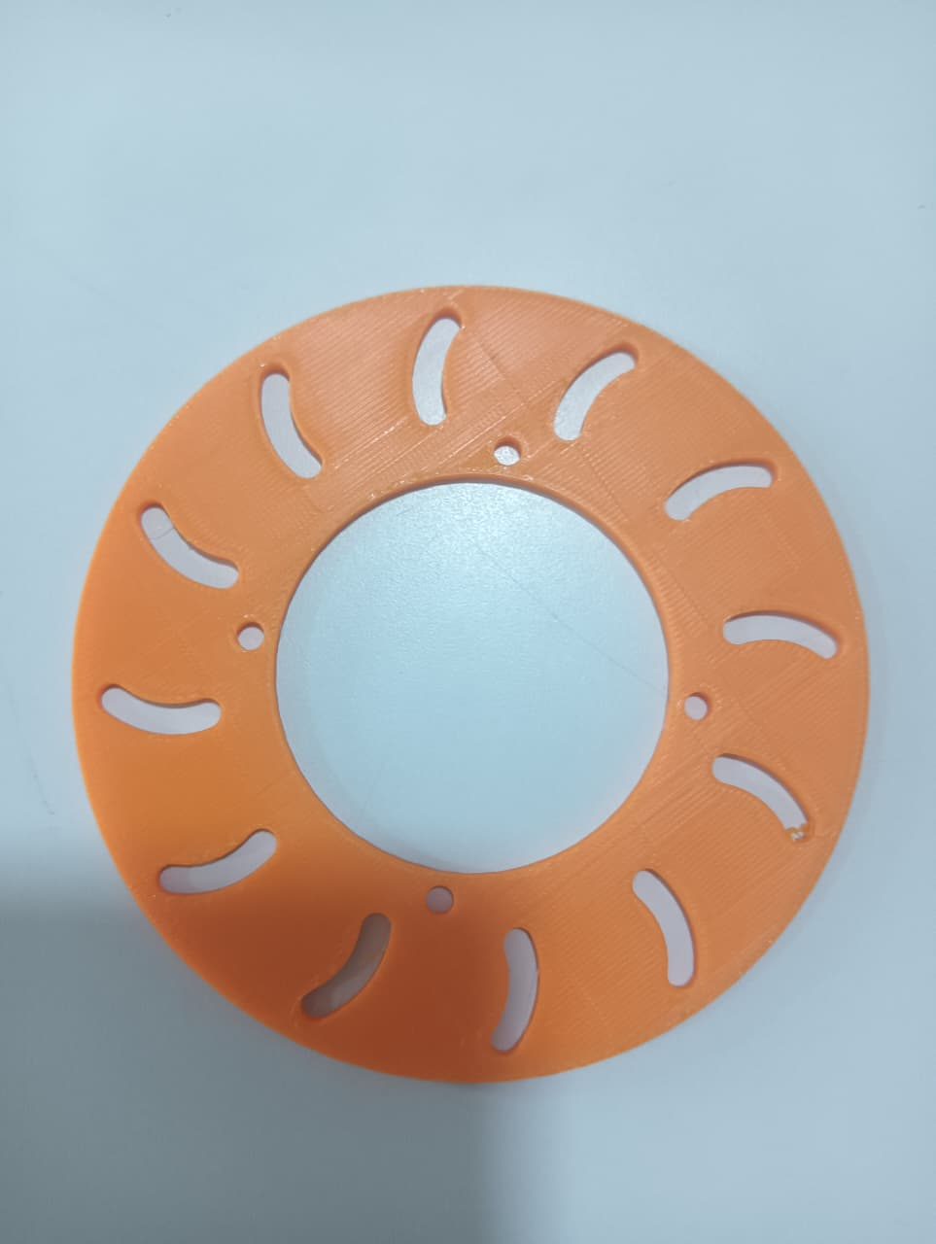
Fabrication of Critical Component Using FDM 3D Printing
For project review, I 3D printed a modified disc using the Fused Deposition Modeling (FDM) method. Given its role as a critical component, I selected PLA filament in orange color to ensure dimensional stability, ease of printing, and high visual contrast for inspection and presentation.
3D printing process
3D printed Disc

Slide 23
BILL OF MATERIAL
Item No. | Part Name | Material | Quantity
1 | Brake Disc (Rotor) | Cast Iron / Stainless Steel | 1
2 | Bolt | High-Tensile Steel | 2–4
3 | Holder (Caliper Bracket) | Cast Iron / Aluminum Alloy | 1
4 | Piston | Aluminum Alloy / Stainless Steel | 1–2
5 | Brake Pad (Friction Lining + Back Plate) | Friction Material: Kevlar/Ceramic/Graphite; Back Plate: Steel | 2
6 | Caliper (Housing) | Aluminum Alloy / Cast Iron | 1

Slide 24
References
Kim, Cheol, Yonghwan Kwon, and Dongwon Kim. "Analysis of low-frequency squeal in automotive disc brake by optimizing groove and caliper shapes." International Journal of Precision Engineering and Manufacturing 19, no. 4 (2018): 505-512.
Belhocine, Ali, and Oday Ibraheem Abdullah. "Thermomechanical model for the analysis of disc brake using the finite element method in frictional contact." Multiscale Science and Engineering 2, no. 1 (2020): 27-41.
Pai, Anand, Vineet Maheshwari, S. V. Shivaditya, Ravindra Mallya, and Satish Shenoy Baloor. "Design and Dynamic Analysis of Metal Matrix Composite-Based Disc Brake Pads for Formula Cars." Journal of The Institution of Engineers (India): Series C (2025): 1-13.

Slide 25

Thank You

